Slide 1
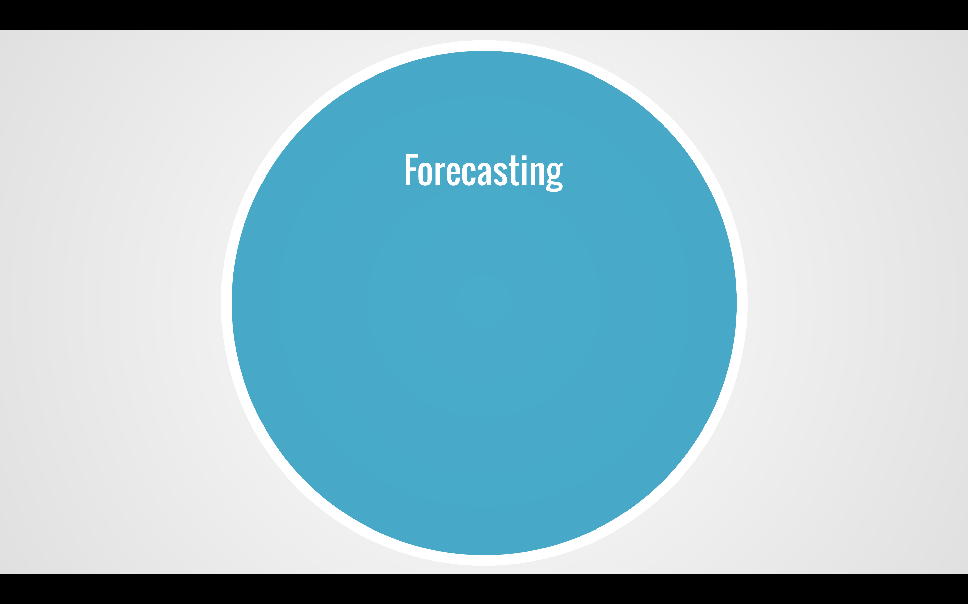
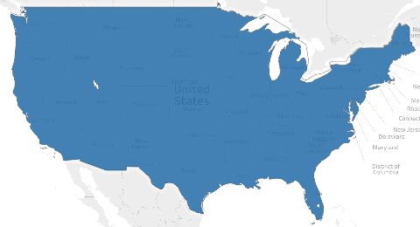
Insert coefficients
Possibly Lasso graph
Elastic Net score

